Slide 1
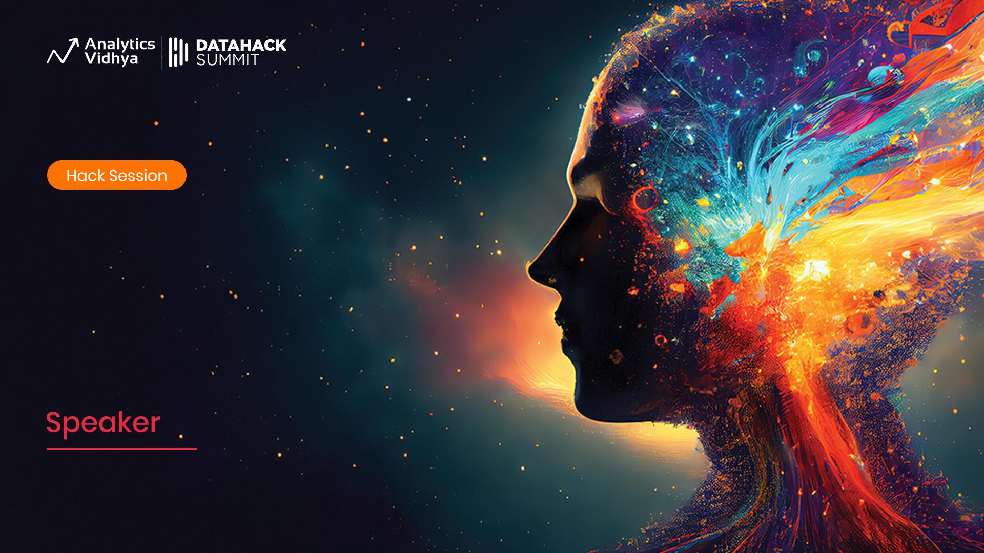
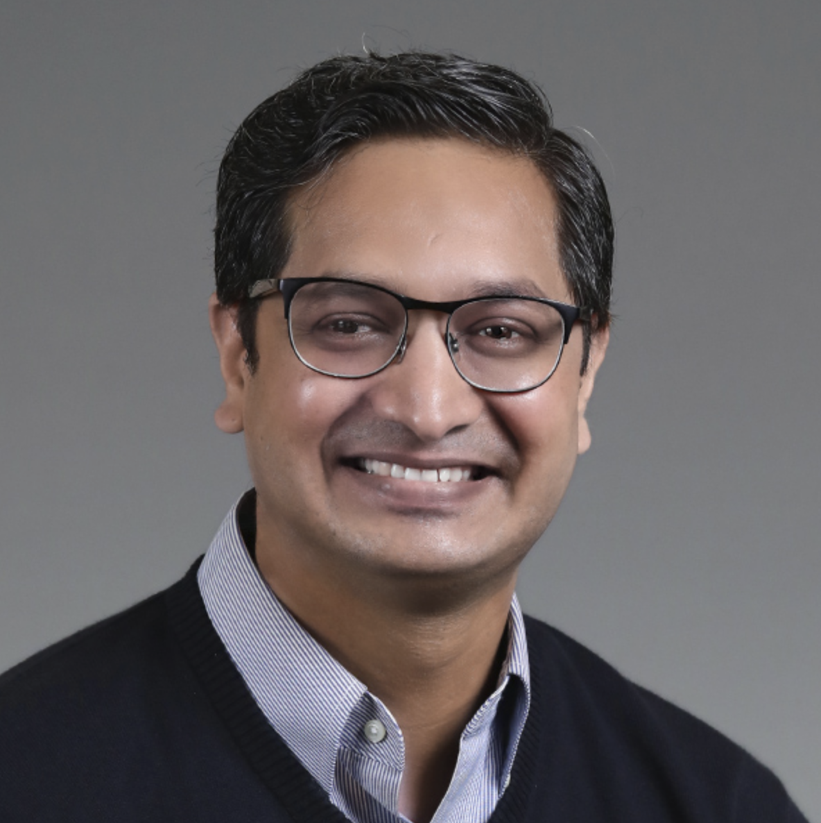
Workshop
Mastering Stable Diffusion
Module 0
Embark on an Exciting Journey with Generative AI
Sandeep Singh
Expert Senior Director, Bain & Co.

Slide 2
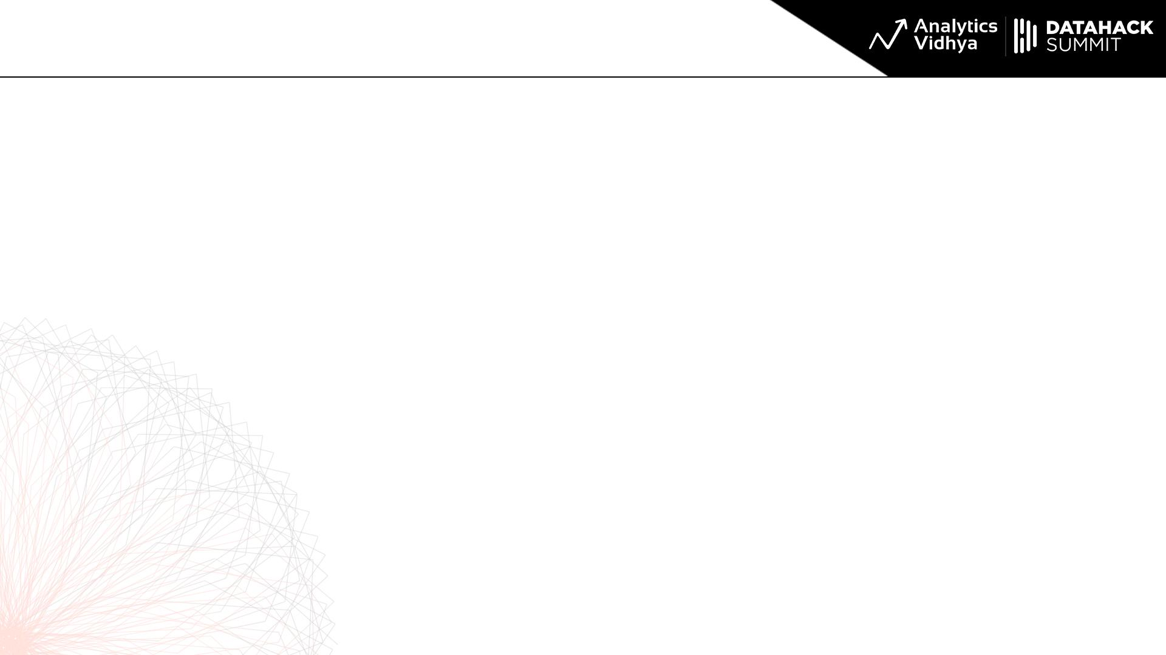
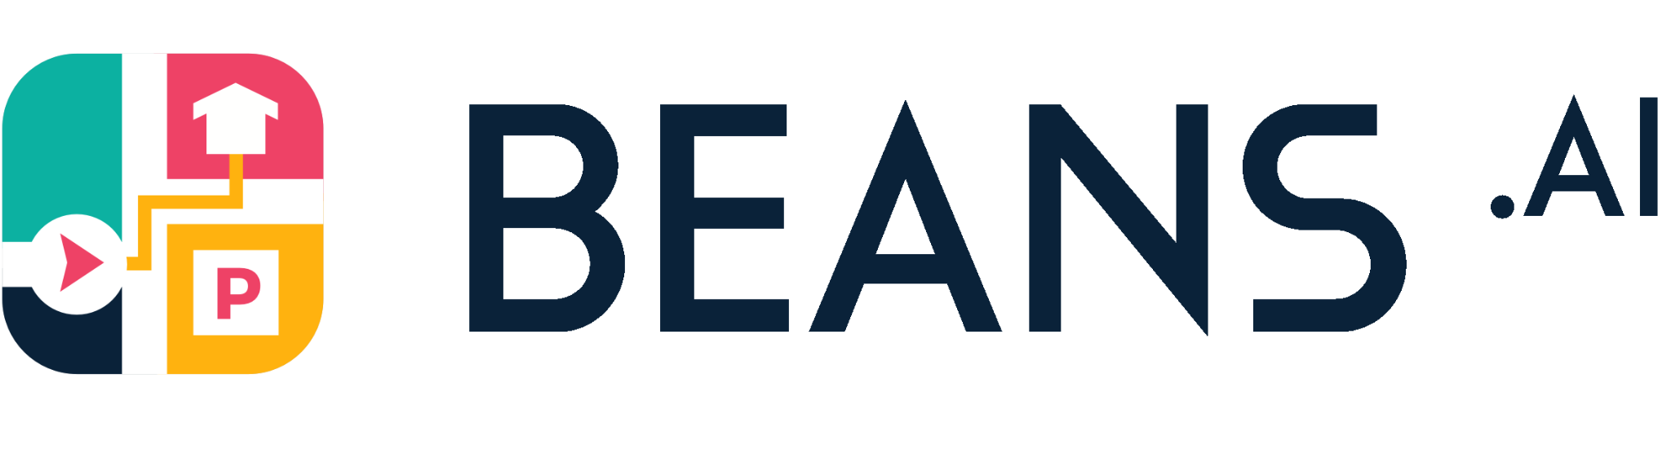
About Me
Head of Applied AI/Computer Vision, Beans AI
Beans AI is in Palo Alto, CA
We are Location Intelligence Platform
Hyper-Accurate Maps, Much more accurate than Google, Apple and Bing
Computer Vision and Image based Synthesis is inherent part of Innovation at Beans Maps
I deal with Satellite Imagery, Location Data, Convexity Optimization domains at my day to day job.
Holds Masters from Georgia Tech.
Active Member of Many AI Initiatives in Silicon Valley.
Victimized by Bangalore Traffic 15 years ago 😂

Slide 3
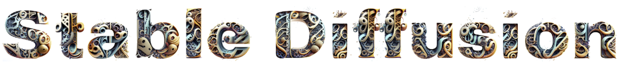
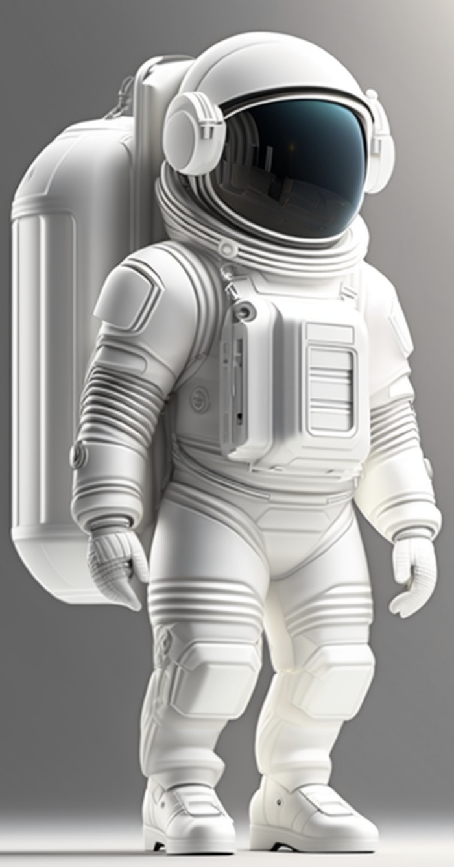
Welcome to "Stable Diffusion"
"Stable Diffusion" is not just a subject or Technology, but a symphony of knowledge, a testament to human curiosity and our ceaseless quest for understanding.
Imagine yourself embarking on a journey of discoveries and Awe-inspiring work.
Allow yourself to be inspired by the beauty of complexity.
Physics Inspired approach to Computer Vision Applications.
Pixel Evolution at Center: Pixels don't merely exist statically. Instead, they evolve and blend organically, much like molecules in a diffusion process, resulting in harmonious and intricate visuals.
Explain the SD Logo Above.

Slide 4
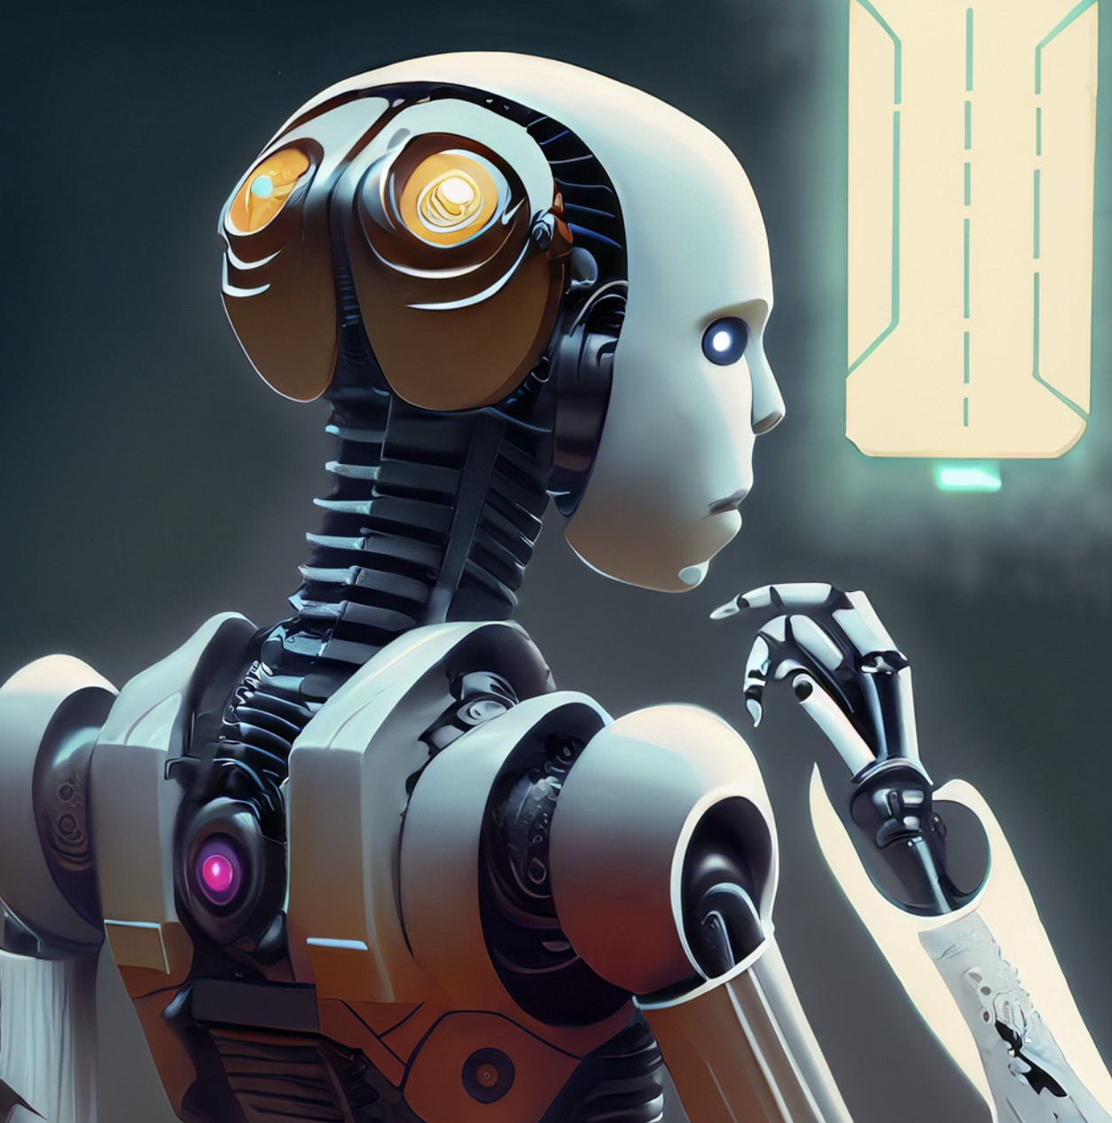
Purpose of Module 0
Mentally orient yourself in the landscape of Stable Diffusion.
Be able to define the field in simplistic terms.
Be abreast of Significant timeline of Stable Diffusion.
Be able to Iterate the big moments of Gen AI.
Know biggest players in the domain.
Signify the particular company in this domain.
Know the epicenter of Innovations happening currently.
Be inspired dig deeper into Module 1.

Slide 5
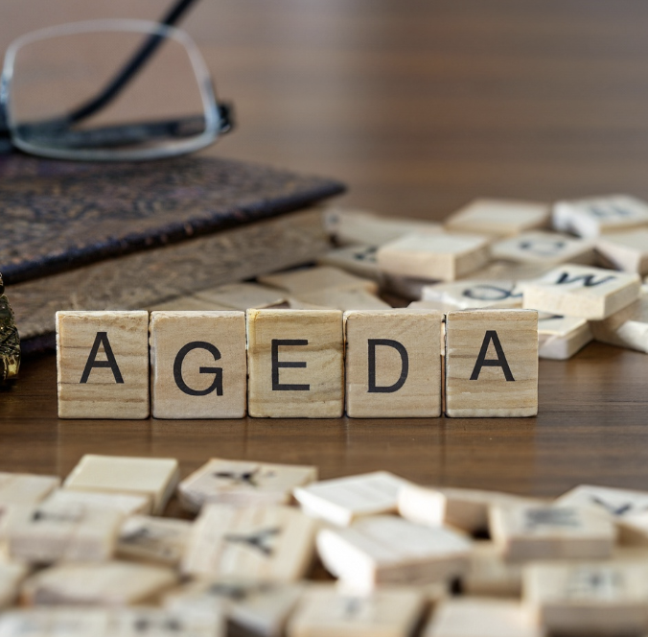
Agenda of Module 0
Revisit the Prerequisites: DL, ML, Optimization fundamentals needed.
Methodology for the Workshop: Math, Computer Science and Software Engineering.
What is Generative AI: Introduction, Landscape, Domains, Sub-Fields.
Why Generative AI: Why it matters, How to augment it, How to Capitalize on it.
History of Generative AI: Short but Significant history, Milestones, Ahha moments.
Why should you care about the history of Stable Diffusion: Professional Impact, Societal Implications, Technology Reshaping Information Exchange.
Applications of Generative AI: An Umbrella look at the Concrete applied Use Cases.
Gauging the State of Art in Stable Diffusion: What and What is the forefront.
We will refer to stable diffusion as SD.

Slide 6
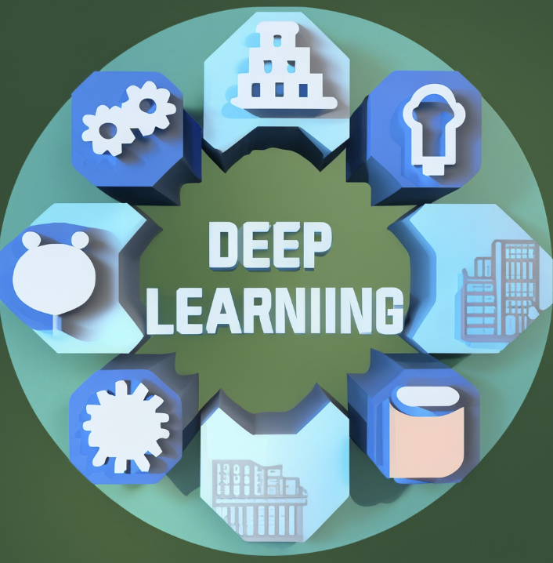
Revisit the Prereqs: DL, ML, Optimization
Deep Learning Concepts to know:
Neural Networks
Activation Functions
Forward Propagation
Backpropagation
Loss Functions
Optimization Algorithms Concepts.
Over-fitting.
Regularization Techniques.
Convolutional Neural Networks (CNNs)
Transfer Learning
Dropout
Batch Normalization

Slide 7
Revisit the Prereqs: DL, ML, Optimization
Neural Networks: Computational model consisting of layers of interconnected nodes or "neurons" that process and transform input data.
Activation Functions: Mathematical functions applied to the output of each neuron, introducing non-linearity to model complex patterns.
Forward Propagation: The process by which input data is passed through the layers of a neural network to produce an output.
Backpropagation: A training algorithm used to adjust the weights of a neural network by calculating the gradient of the loss function with respect to each weight.
Loss Functions: Mathematical functions that measure the difference between the predicted output of a neural network and the actual target values.
Optimization Algorithms: Algorithms designed to minimize the loss function by iteratively adjusting the network's weights. Gradient Descent, for example, updates weights in the direction of the steepest decrease in loss.
Over-fitting: A modeling error that occurs when a neural network is too complex and starts to memorize the training data rather than generalizing from it.
Regularization Techniques: Methods used to prevent overfitting.
Convolutional Neural Networks (CNNs): A type of neural network designed for processing grid-like data, such as images, using convolutional layers to detect local patterns.
Transfer Learning: A technique where a pre-trained neural network on one task is fine-tuned or adapted for a different but related task, leveraging previously learned features.
Few more terminologies like Dropout, Batch Normalization etc.

Slide 8
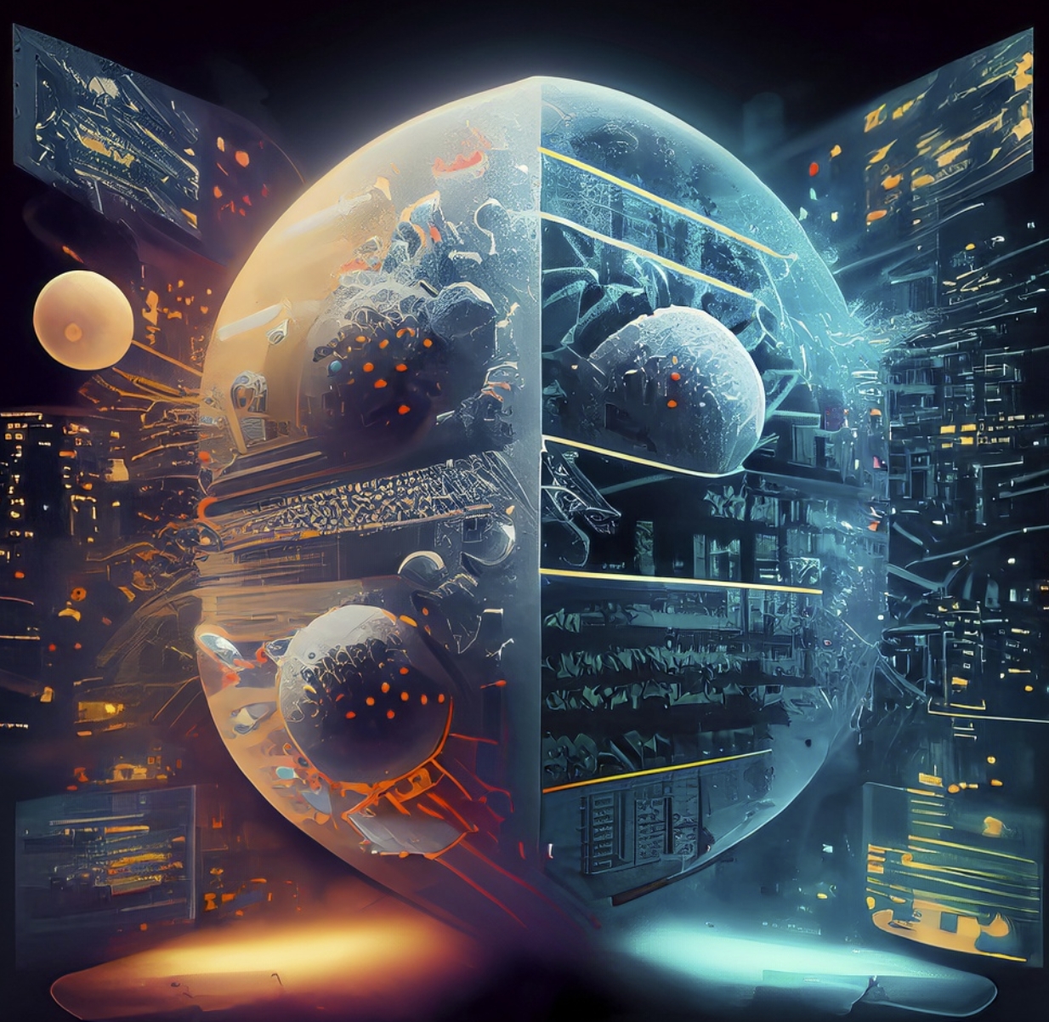
Methodology for the Workshop
Fusion of Approaches from:
Math, Computer Science and Software Engineering
Holistic Problem-Solving: Mathematical rigor, Computational logic, Algorithmic.
Top-Down Approach: Learn to use, Understand to build.
Simplistic, but not Simple: Complex ideas in simple words without loss in fidelity.
Terminology Resolution: Many things means different things across these domains. Need to be resolute.
Iterative Development: Refine Mathematical models and software as for previous outcomes.
Rapid Prototyping: Leveraging software engineering tools and platforms to quickly turn ideas into working prototypes, accelerating innovation and testing.

Slide 9
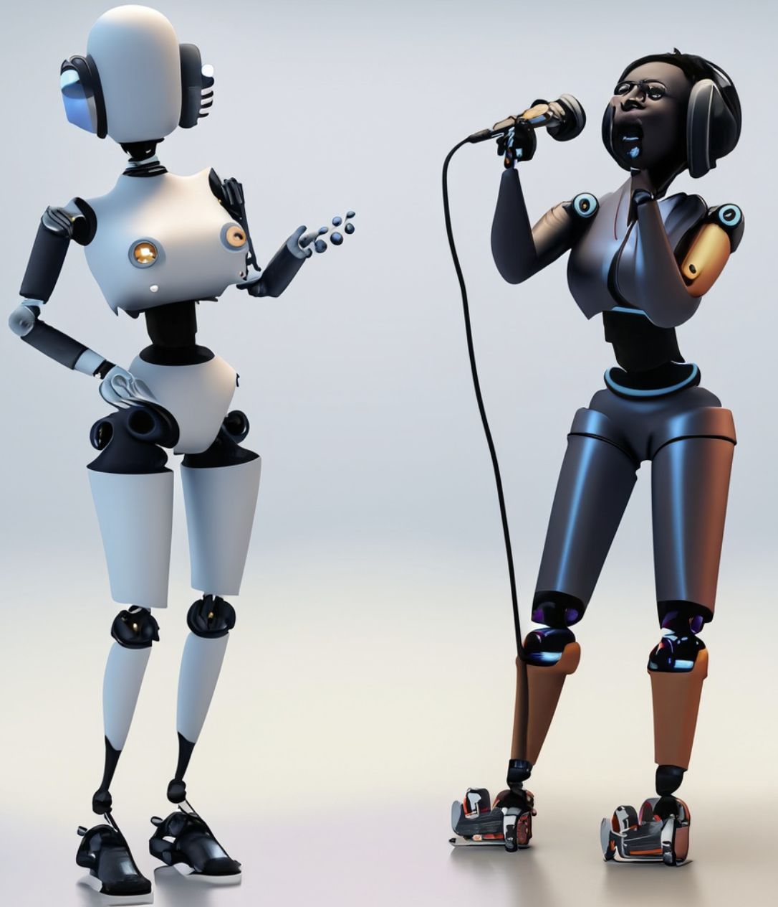
What is Generative AI: Introduction
Beyond Traditional AI: Most AI models analyze or process data for predictions or decisions, While GenAI creates something novel from learned patterns.
Rooted in Neural Networks: Gen AI primarily employ neural network to learn and produce new patterns.
Diverse Applications: Art, music, Product design, medical research, GenAI's potential spans multiple domains.
Paradigm Shift: Challenges conventional thought on creativity and production, blurring the lines between human and machine-generated content.
Transformative Potential: GenAI is not just a tool but a transformation in AI's role, positioning it as a co-creator in numerous fields.

Slide 10
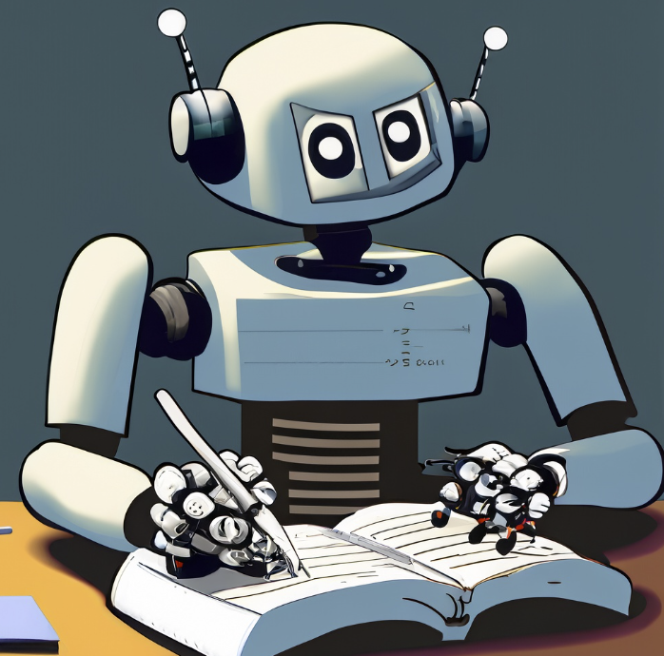
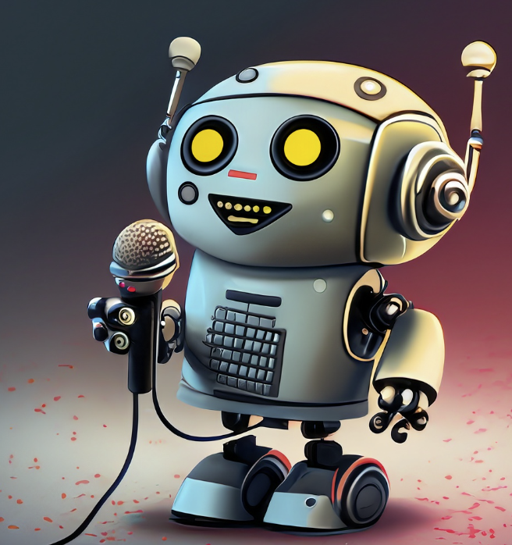
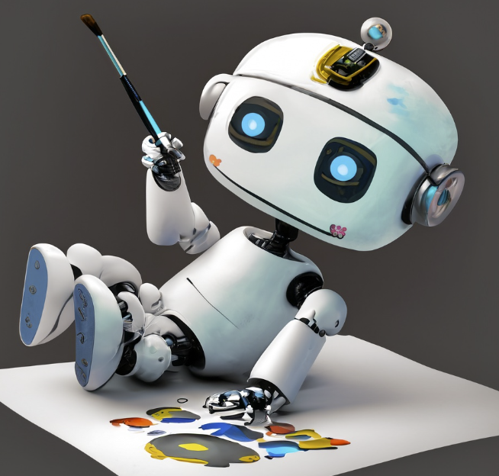
What is Generative AI: Landscape
Generative AI
Text(e.g. LLMs)
Audio(e.g. MusicLM)
Image and Video(e.g. Stable Diffusion, Dall-e2)

Slide 11
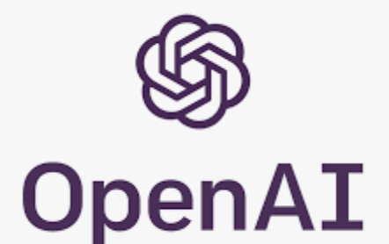






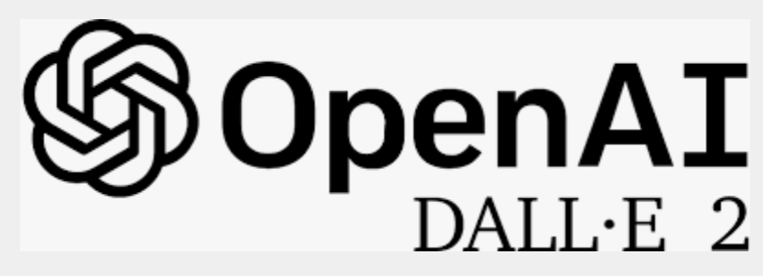


What is Generative AI: Landscape
Generative AI
Text(e.g. LLMs)
Audio(e.g. MusicLM)
Image and Video(e.g. Stable Diffusion, Dall-e2)

Slide 12
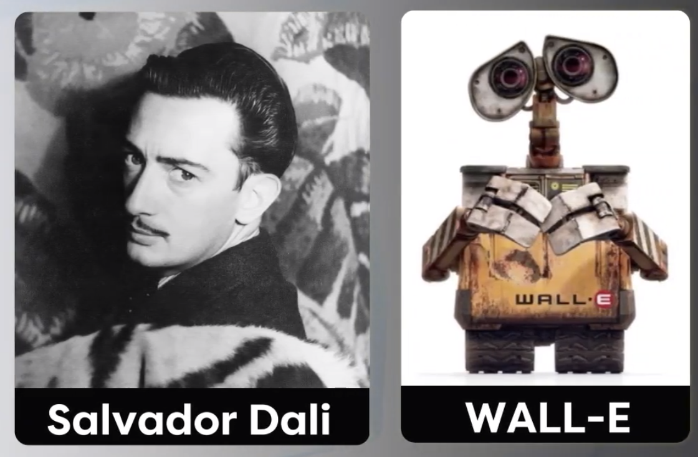
What is Generative AI: Landscape
Insane Valuation of GenAI Companies:
OpenAI: 30B
Anthropic: 4.2B
Cohere: 2.1B
RunwayML: 500M
Popular GenAI Tools:
ChatGPT by OpenAI
Bard by Google
CoPilot by Github
Codex by OpenAI Dall-E2 by OpenAI
Firefly by Adobe
Stable Diffusion by Stability.ai
Mid Journey by David Holz
Designer by MicroSoft
Gen-2 by Runway ML
Diverse Applications: Art, music, Product design, medical research, GenAI's potential spans multiple domains.
Paradigm Shift: Challenges conventional thought on creativity and production, blurring the lines between human and machine-generated content.
Transformative Potential: GenAI is not just a tool but a transformation in AI's role, positioning it as a co-creator in numerous fields.
Fun Fact: Dall-E2 named after:

Slide 13
What is Generative AI: Applied Domains
Art & Media Creation: Generation of original artwork, graphics, music compositions, and videos.
Fashion Design: Crafting new apparel designs, predicting fashion trends, and visualizing accessory combinations.
Medicine & Drug Discovery: Simulating molecular structures for potential new drugs and predicting their interactions.
Gaming: Automated generation of gaming environments, characters, plots, and assets for more dynamic experiences.
Text & Content Creation: Coherent and contextually relevant articles, stories, or scripts.
Virtual Reality (VR) & Augmented Reality (AR): Generating immersive environments or objects for interactive experiences.
Architecture & Urban Planning: Simulating architectural designs, layouts, and urban scenarios.
Finance: Simulating market conditions and strategies for investment and risk assessment.
Personalized Marketing: Creating tailored content, advertisements, or product suggestions based on user preferences and behaviors.
Natural Language Processing: Translating languages, crafting dialogue for chatbots, or generating contextually relevant text suggestions.

Slide 14
History of Generative AI
Classical History of GenAI
Early Inspirations (1940s-1950s): The perceptron, introduced by Frank Rosenblatt in 1958, meant for pattern recognition, a distant precursor to today's GenAI.
Rise of Boltzmann Machines (1980s): Geoffrey Hinton did an early attempt to model data distributions probabilistically.
Breakthrough with RBMs (2000s): RBM provided a more efficient way to train layers in neural networks and laying the groundwork for deep learning.
Deep Learning Renaissance (2010s): With AlexNet, The success of DNN in image and speech recognition cascaded into explorations in data generation.
Ah-ha Moment with GANs (2014): The introduction of Generative Adversarial Networks (GANs) by Ian Goodfellow and his colleagues was a landmark moment. This revolutionary model, consisting of a generator and discriminator in competition, quickly became the cornerstone for many generative projects.
Variational Autoencoders (2013-2014): Almost in parallel with GANs, VAEs emerged as another powerful tool for generative tasks, providing a probabilistic manner to describe observations in latent spaces. (Most Important for SD)
Natural Language Processing Breakthroughs (2018-2020): With models like OpenAI's GPT series, the power of generative AI was harnessed to produce human-like text, showcasing its vast potential in content generation and interaction.

Slide 15
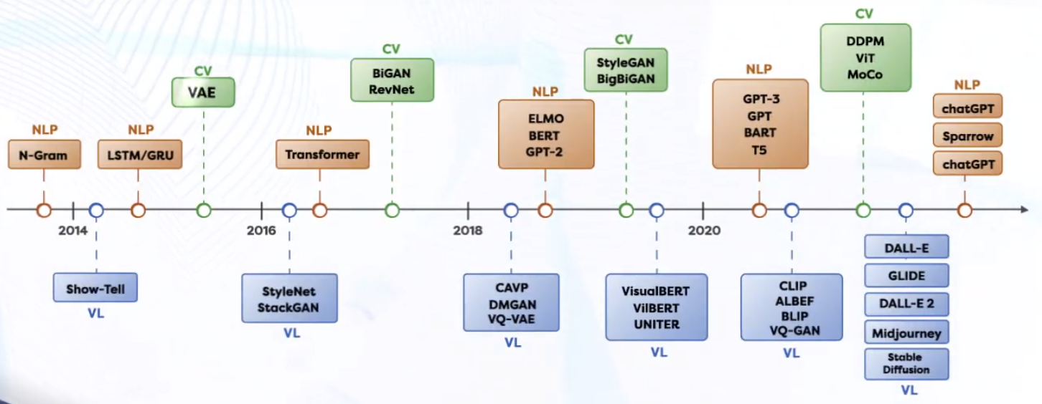
History of Generative AI
Modern/Immediate History of GenAI

Slide 16
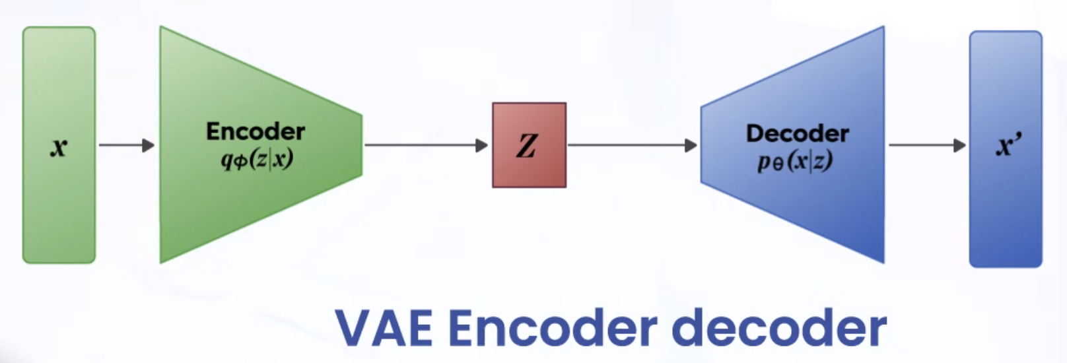
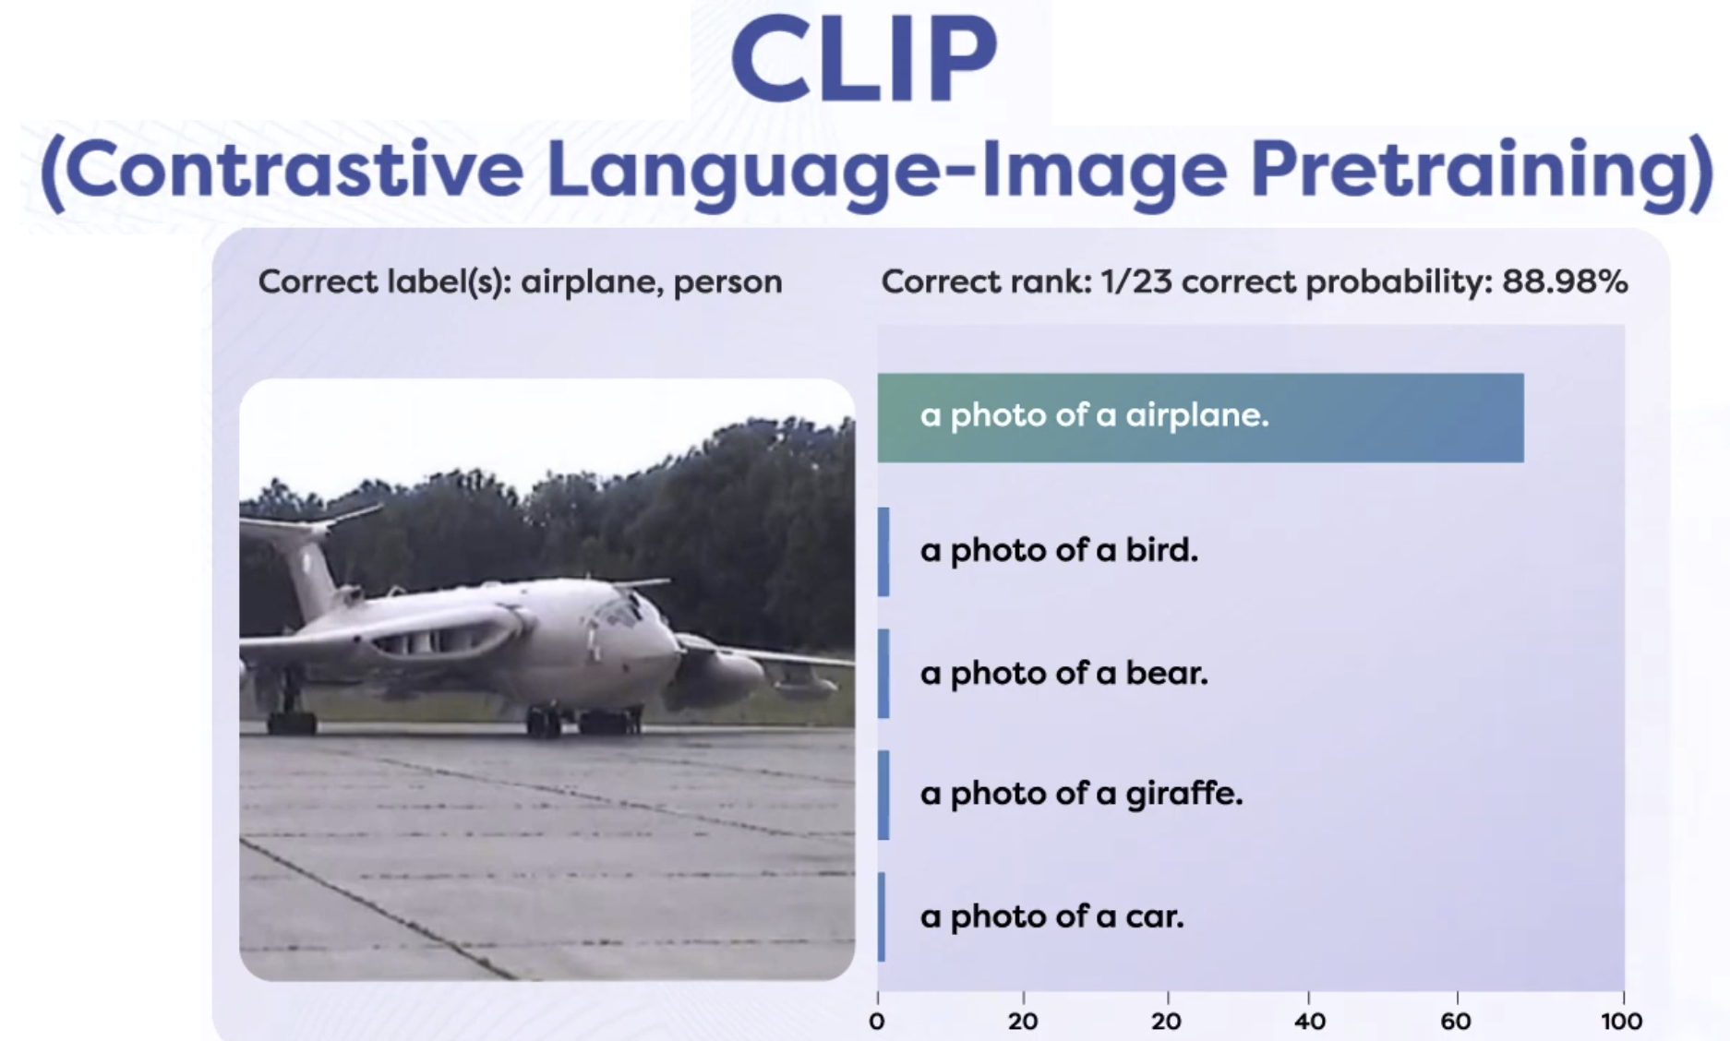
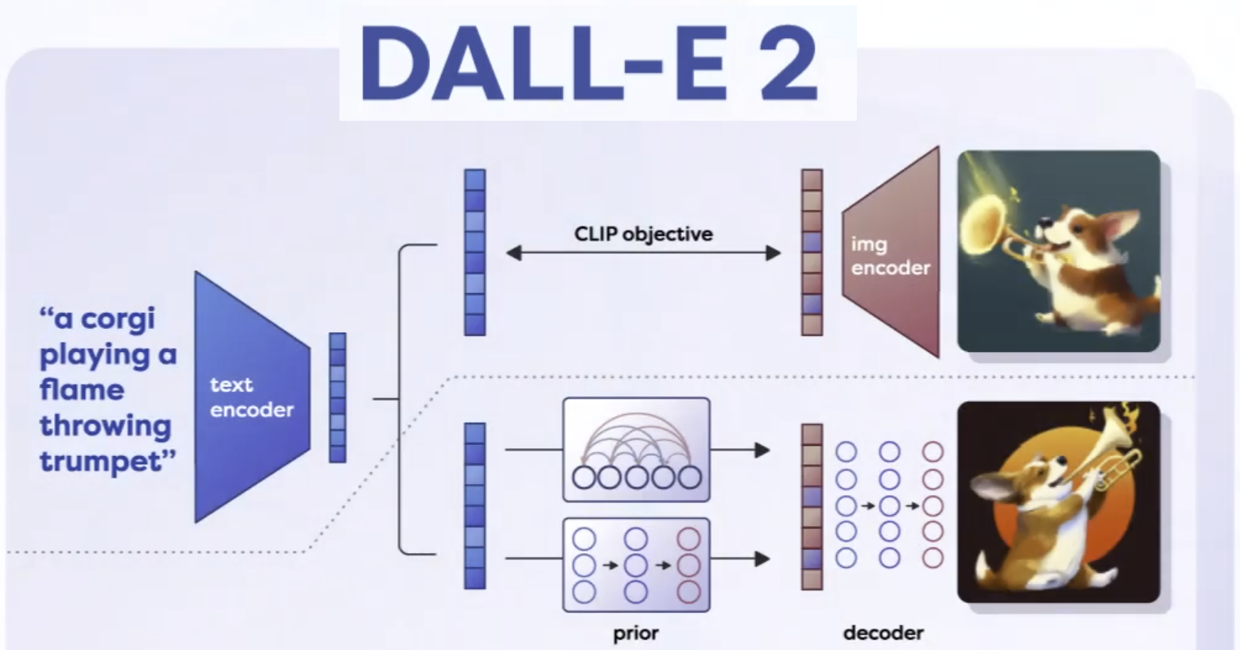
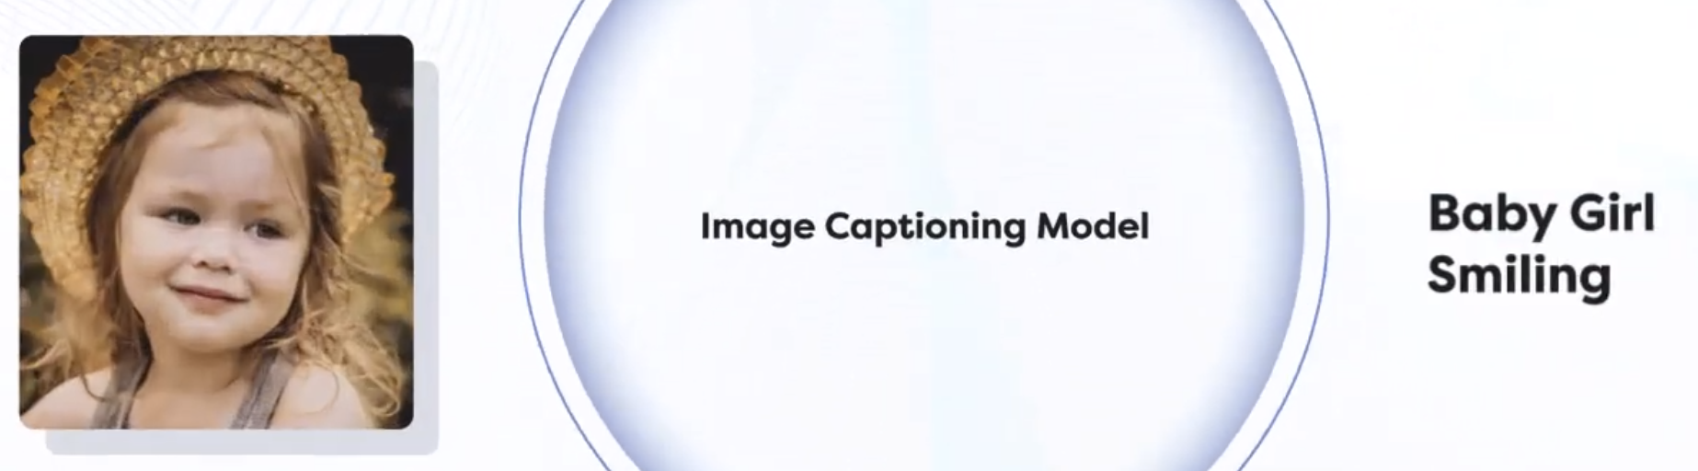
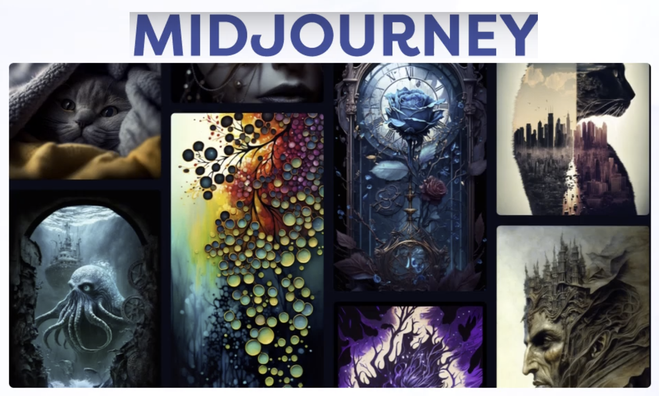
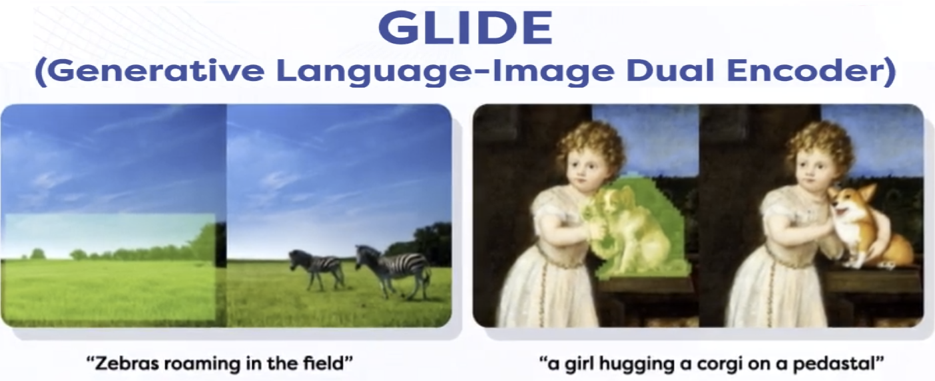
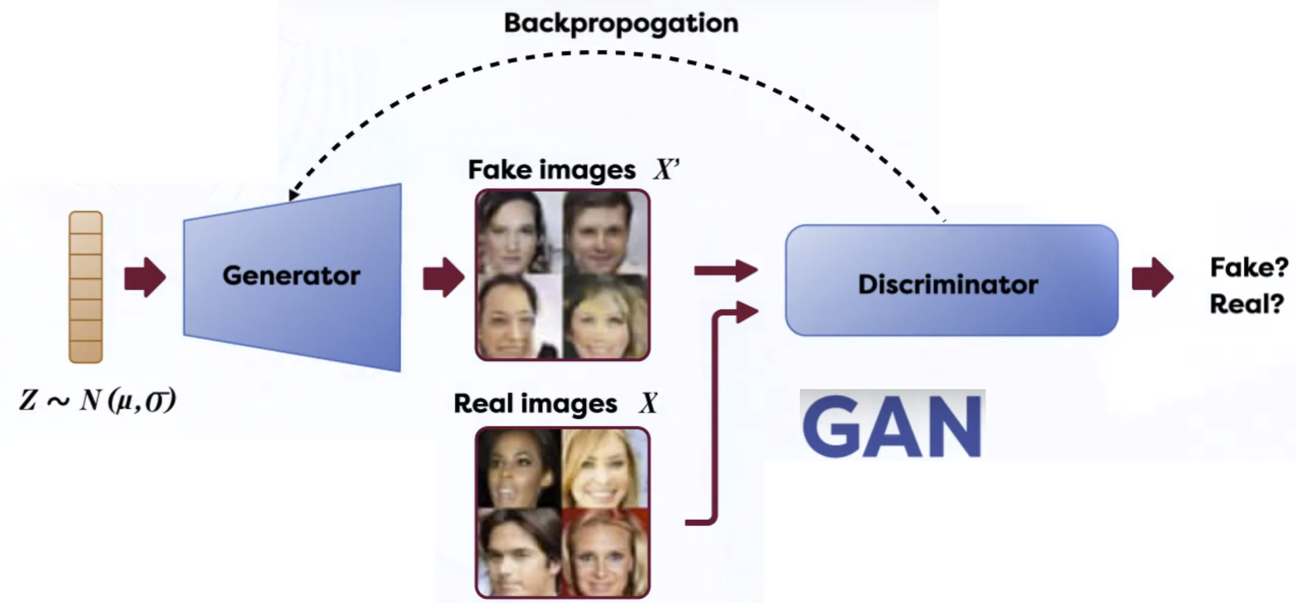
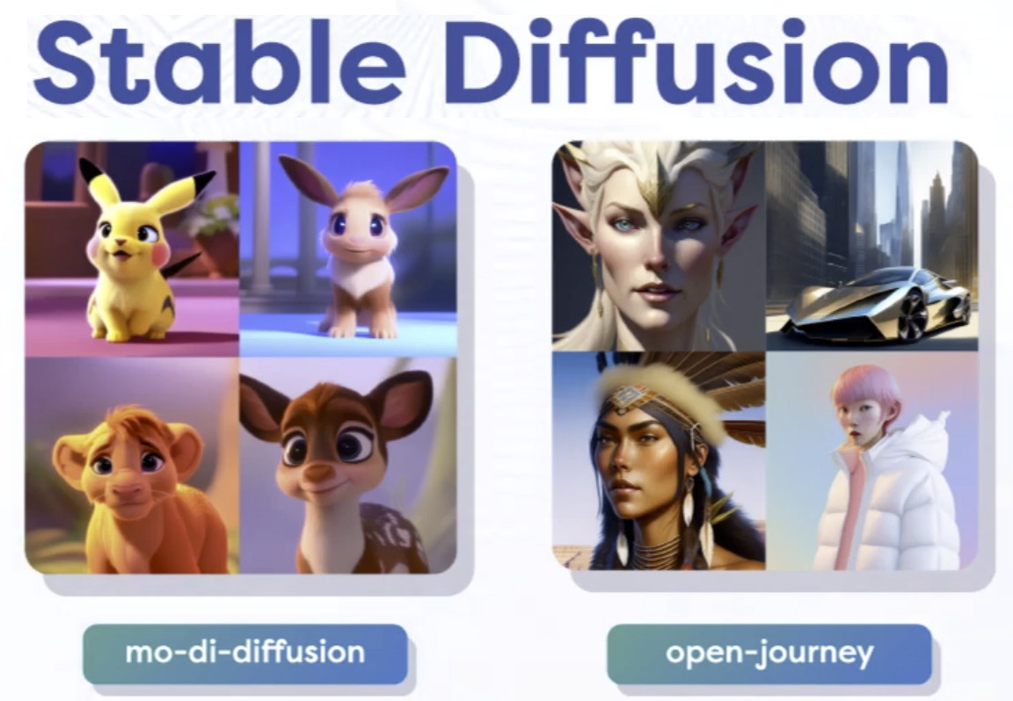
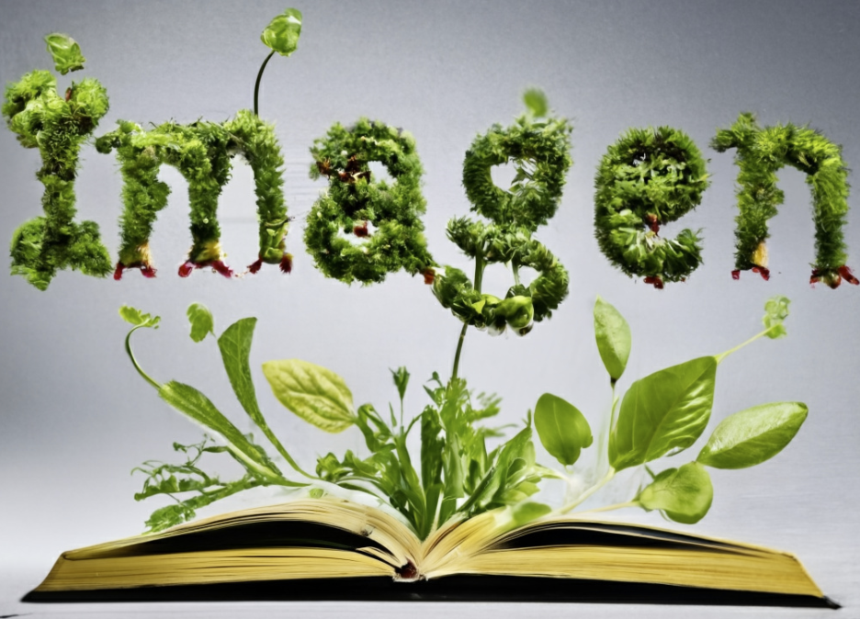
Models We will Dig Deeper
Show-and-Tell

Slide 17
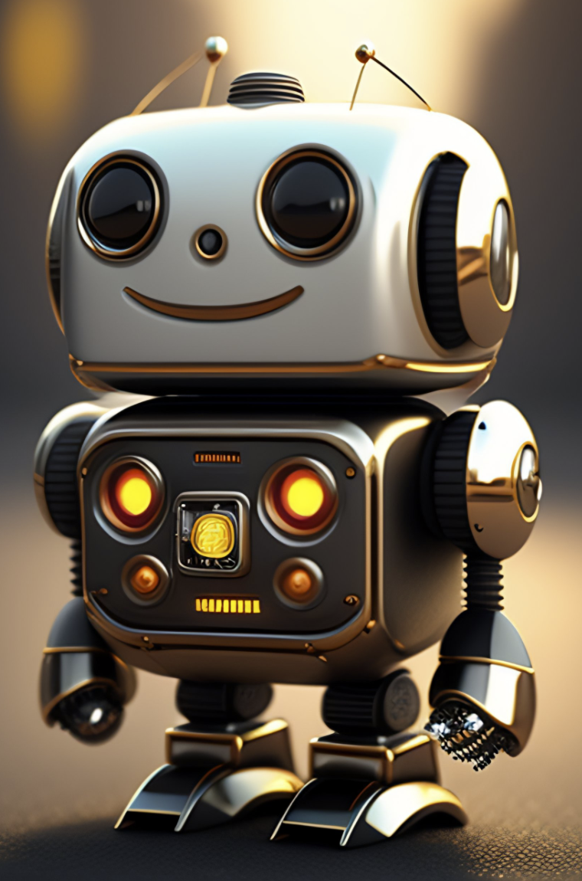
Questions?

Slide 18



